Slide 1
Binary Search Tree
ABDUL RAHEEM RIHAM AHAMED
HND COMPUTING IDM

Slide 2
Contents
Big(O) graph of Elements against Operations
BST vs. Hash Tables
BST vs. RBTs
BST vs. Linked Lists
BST vs. Graphs
Justification
Reference

Slide 3
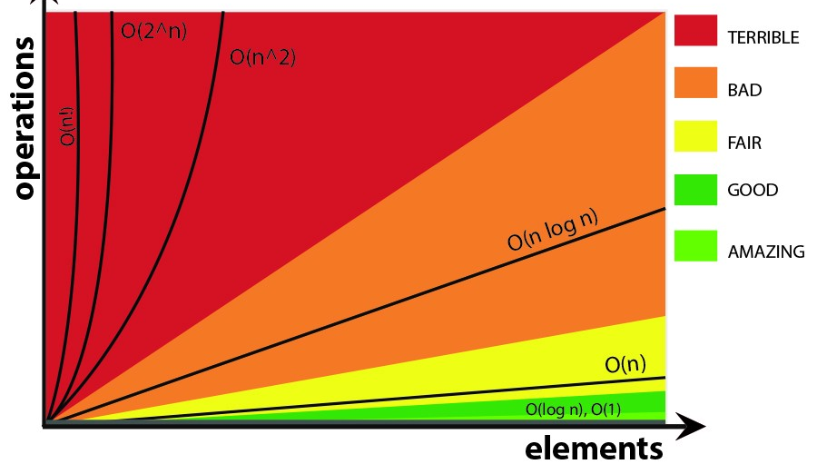
Big – o Complexity chart
Although not mentioned in the above graph, O(1) falls under “amazing” category, making constant time complexity the best.
Notes:
Comparisons of performance and how efficient a data structure is will be made with the help of the Big O algorithm
Please reference this graph when time complexity of a data structure is mentioned at any point.

Slide 4
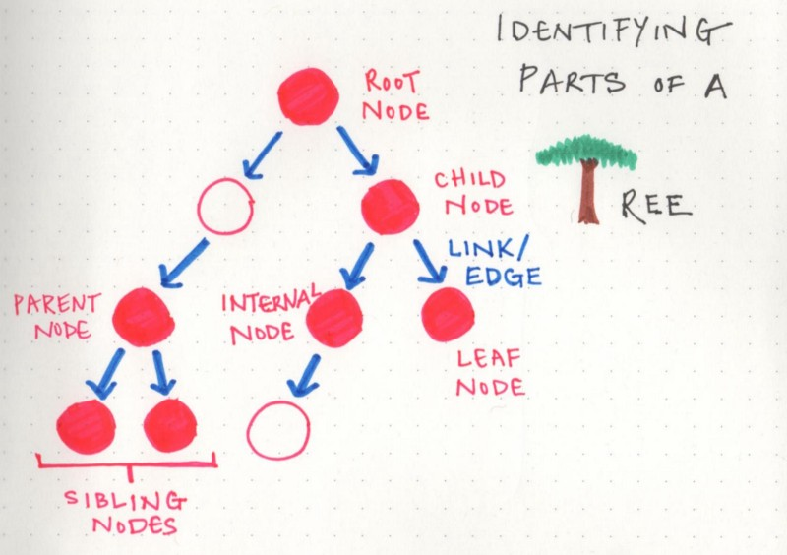
Binary Search Trees
Notes:
A BST is a node-oriented tree type data structure that has a particular set of rules that binds to the tree, as such there are certain naming conventions;
The first node in the BST is called a “root”
A series of nodes is called a branch, the last node of a branch is called a leaf.
The node which attaches a node is called it’s a parent while the attached node is called a child.
With the 3 major rules that builds a BST;
The value in the left node must always be lesser than the value of the key node.
The value in the right node must always be greater than the value of the key node.
The branches following a particular node must also obey the above rules.

Slide 5
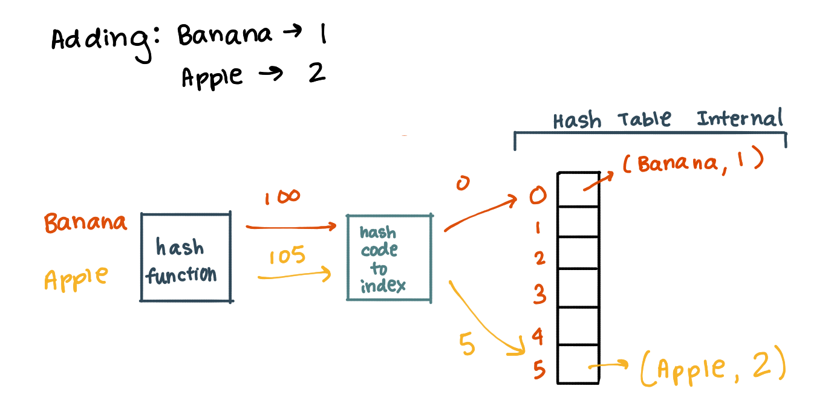
BST vs Hash Tables
Notes:
Binary search trees, perform the general 3 functions search, insert and delete in the time complexity of O(n) where n is the number of nodes, but Hash tables provide these features at O(1) time complexity.
Even if it were a self balancing BST, these general functions are performed at O(logn)
As such Hash Tables generally perform better than BSTs.
However, there are very obvious use cases of BSTs that triumph over Hash tables.
In-order traversal in a BST provides data in a sorted manner, which is not native to hash tables.
BSTs are easier to implement than a hash table, even if it’s a custom BST. Hash tables require hashing, which usually require a 3rd party library.
Performing range queries, finding max, min or smallest value already exist in a BST while a Hash table doesn’t.
4. BSTs require balancing so as to not increase overhead. Hash tables do not require balancing.
Generally, BSTs and Hash tables are used in many languages to implement maps or sets.

Slide 6
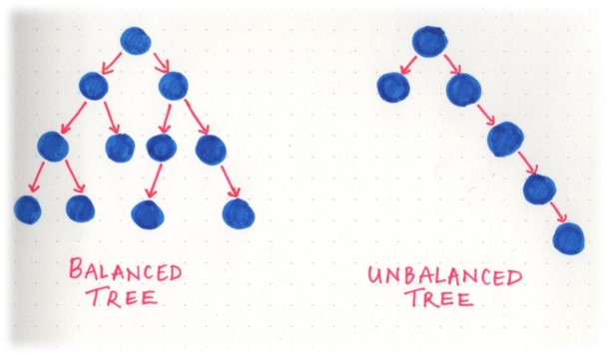
BST vs Red-black tree
Notes:
A red-black tree is a self balancing tree unlike binary-search, so the time taken to perform searches and insert are much lower in RBT than a BST.
An RBT is not an entirely different data structure, it retains the same concepts and contains the properties of a BST but due to it’s self-balancing feature, an RBT tends to have time complexity that is logarithmic while BSTs with their long branches tend to have a linear time complexity.
As such a RBT can be said to be generally faster but this boost in speed can only be noticeable with large number of nodes.
All functions search, insert etc. are noticeably but not significantly faster for few nodes.
Be it worst or best case time complexity, an RBT is logarithmic- o(log(n)) while a BST will be logarithmic in the worst case and constant in best case.

Slide 7
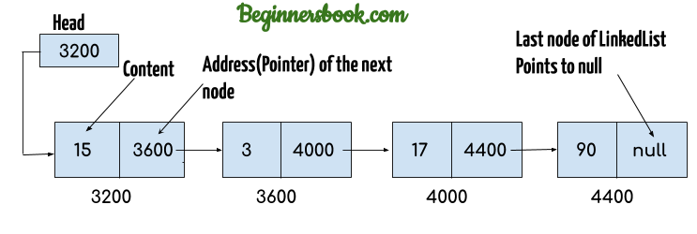
BST vs Linked List
Notes:
A linked list has all it’s items linked together one after another, so the higher number of items the longer the access path.
However given that the BST is balanced, the access path could be considerably lesser than when a linked list is concerned.
A linked list is a fundamental type of data structure, so usually it is used to implement other data structures even a BST, so why compare these 2?
Simply, because implementing a BST using a linked list is inefficient despite the type of linked list involved.
True, a linked list is pointer-based but a BST is a pointer-based tree, as such the time complexity gradually tends to y axis in a graph of operations against elements.

Slide 8
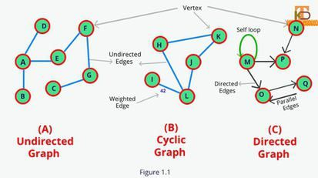
BST vs Graphs
Notes:
Trees in general are a more restricted version of a graph, this theory applies to BSTs as well.
A BST and all trees are categorized as Directed Acyclic Graphs, or DAGs for short.
A common misconception is that new programmers that have learnt about graphs, tend to think that BSTs do not have a direction restriction, which is false. BSTs do have a direction, but not in the way that A goes to B, but that A is a parent of B or B is a child of A, a direct relationship is established.
Due to this false misconception, new programmers tend to avoid BSTs.
BSTs are considerably less complex than a graph, as a BST does not have loops, circuits etc.
BSTs fall under hierarchical model, while a graph falls under the network model.
Graphs do not contain the concept of a “root”, they also do not have a parent-child relationship with each element.
While graphs have no restrictions in terms of connecting with edges, BSTs do as have been pointed earlier.
Graphs are categorized as directed and undirected, and employ a concept of “edges” and “vertices”
Graphs are usually implemented using multi-dimensional arrays, which is called an adjacency matrix or adjacency list if implemented using a linked list.
Implementing a graph must be carefully thought, due to the complexity of the data structure, for a new programmer it is much recommended to go for a BST instead.

Slide 9
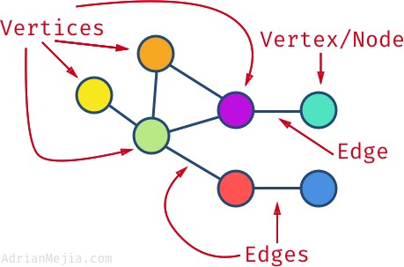

Slide 10
Justification
This presentation compares the data structure of the binary search tree with comparable data structures.
As such, a BST will not be compared to a data structure such as a stack as these 2 data structures were introduced to solve different problems, therefore they have different usage scenarios and are ultimately not comparable in a sensible way.
All of the equations in this presentation are industrially active and widely used, making them perfect candidates for introducing new programmers.

Slide 11
Reference
DISQUS (2021) bigocheatsheet, Available at: https://www.bigocheatsheet.com/ (Accessed: 15th July 2021).
tutorialspoint (2021) Data Structure - Binary Search Tree, Available at: https://www.tutorialspoint.com/data_structures_algorithms/hash_data_structure.htm (Accessed: 15th July 2021).
tutorialspoint (2021) Data Structure - Graph Data Structure, Available at: https://www.tutorialspoint.com/data_structures_algorithms/graph_data_structure.htm (Accessed: 15th July 2021).
tutorialspoint (2021) Data Structure and Algorithms - Hash Table, Available at: https://www.tutorialspoint.com/data_structures_algorithms/hash_data_structure.htm (Accessed: 15th July 2021).
tutorialspoint (2021) Data Structure and Algorithms - Linked List, Available at: https://www.tutorialspoint.com/data_structures_algorithms/linked_list_algorithms.htm (Accessed: 15th July 2021).
tutorialspoint (2021) Red-Black Trees in Data Structure, Available at: https://www.tutorialspoint.com/red-black-trees-in-data-structure (Accessed: 15th July 2021).

Slide 12
THANK YOU

